Slide 1
Data-oriented Content Query System: Searching for Data into Text on the Web
Mianwei Zhou, Kevin Chen-Chuan Chang
Department of Computer Science
UIUC

Slide 2
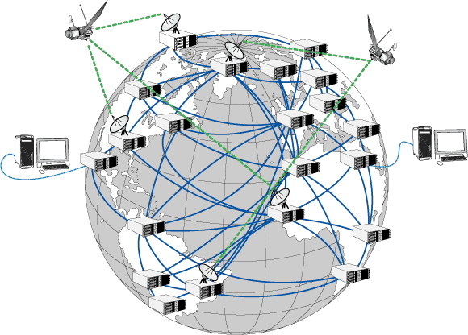
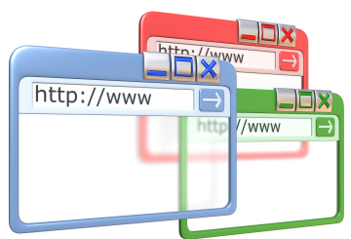
Many Web Applications Try to Exploit the “Content” of Web Pages.
In most cases, what we really want are not pages, but the information units inside.
Web Info Extraction
Typed Entity Search
Web-based Q/A
? ?

Slide 3

Content-Exploiting Application 1:
Web Information Extraction
Web Information Extraction (WIE)
(Marius 2006, Cafarella 2005, Etzioni 2004)
Disease | Death
Influenza | 63730
Penumonia | 61776
… | …
Pattern:
“#Number people die of #Disease each year”
Limitation
Focus on simple patterns.
Lack of interactivity.
Specialized Information Extractors

Slide 4

Content-Exploiting Application 2:
Web-based Question Answering
Web-based Question Answering (WQA)
(Wu 2007, Lin 2003, Brill 2002)
How many people die from seasonal flue each year in US?
Around 36,000
Limitation
Only rely on top-k pages to
retrieve the answer.
Keywords:
“seasonal flu death”
Parse Top-k results

Slide 5


Content-Exploiting Application 3:
Typed-Entity Search
Typed-Entity Search (TES)
(Cheng 2007, Cafarella 2007, Chakrabarti 2006)
Amazon Phone
Ranked Entity List
Limitation
Limited Number of Data Type
Lack of Flexibility
0.90
0.80
0.60
…
…
But … Where is Professor

Slide 6
General System for Querying Text “Content”, Much Like How DBMS Supports Data Application
Web Info Extraction
Typed Entity Search
Web-based QA
? ?
Data-oriented Content Query System
Requirements
Extensible Data Types
Flexible Contextual Patterns
Customizable Scoring

Slide 7
System Framework
Input: CQL Output: Table
Common Users
Output
Expert Users
Entity Search
Web QA
Input: CQL (Content Query Language)
Data-oriented Content Query System

Slide 8
Demo
Online Demo
http://wisdm.cs.uiuc.edu/demos/docqs

Slide 9
Why Relational Model:
Occurrence->Tuple
What we need
Relational Model
Number
Organization
Person
Location
Person
Number
Organization
Location

Slide 10

Why Relational Model:
Content Query->Relational Operation
What we need
Relational Model
Find the population of China
FROM #number
China has a population of 1.3 billion
China with its population of 1.3 billion people
China is established in 1949.
Shanghai is the largest city with 15 million inhabitants in China
WHERE pattern(…)
GROUP BY #number
1.3 billion
15 million
…
ORDER BY conf()
1.3 billion
15 million

Slide 11
Why Relational Model
Extensible Data Type->View
What we need
Relational Model
View
Population
Table
population
Number
Phone
Price
Number
Capital
price
Location
Headquarter
Person
CEO
Professor
phone
President

Slide 12

Main Technique: Highly Efficient and Scalable Index Structure
INPUT
SELECT …
FROM …
WHERE …
OUTPUT
Data Type Definition
Experimental Result
Speed improvement: 6-10 times
Space overhead: Around 2 times original corpus size.
Data Type Repository
Parsing Layer
Execution Tree
Query Optimization
Graph Coverage Problem
Index Selection Module
Index Design
Special Inverted Index
Contextual Index
Join Index
Index Layer

Slide 13
Data-oriented Content Query System:
Supporting Ad-hoc, Interactive “Content” Search.
Web Info Extraction
Typed Entity Search
Web-based Q/A
Data-oriented Content Query System
Interactive
Ad-hoc

Slide 14
Q & A
Thank You!

