Slide 1
Statistical Topic Models for Integrating and Analyzing Opinions in Blog articles
Yue Lu
Qiaozhu Mei
ChengXiang Zhai

Slide 2
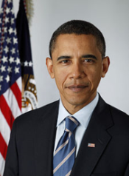
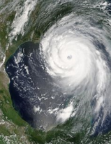

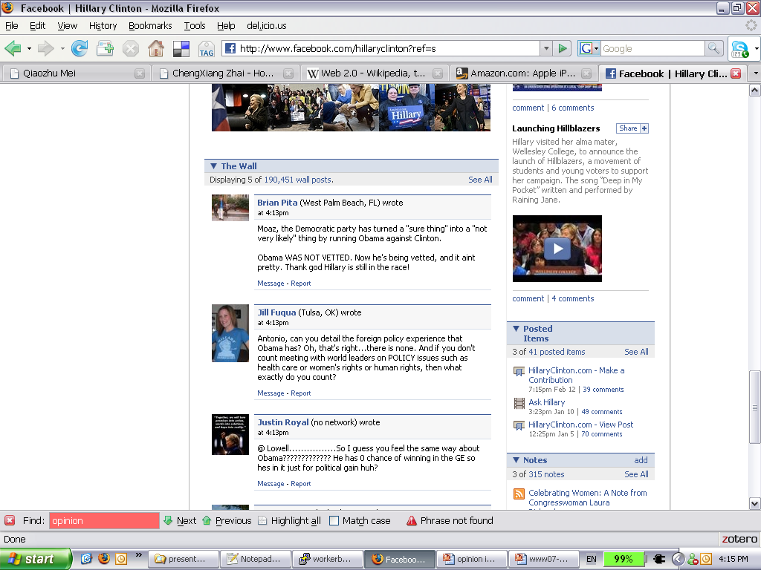

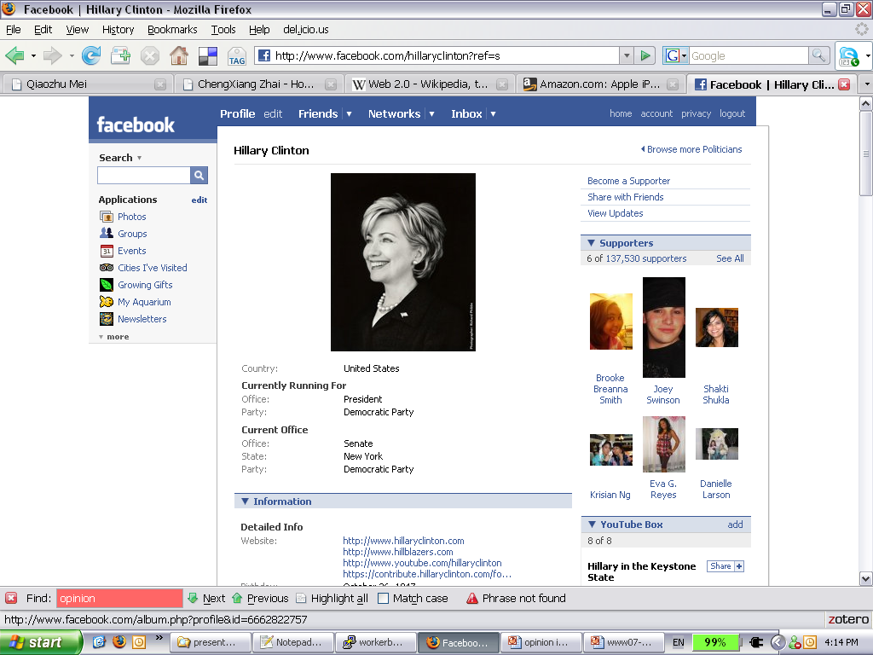
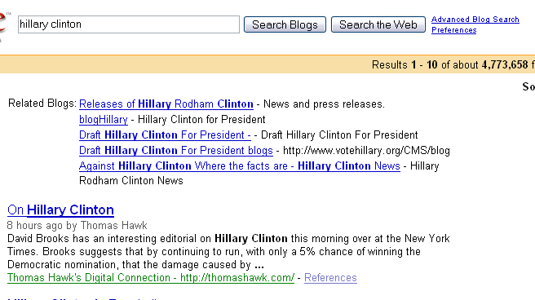

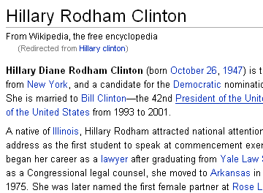

Why Opinion Integration?
What have been said about Barack Obama? the health care reform? Hurricane Katrina? Al-Qaeda?
190,451 posts
4,773,658 results
How to digest all?

Slide 3
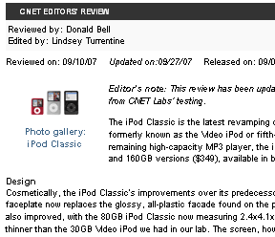

Opinions Come in Two Kinds
190,451 posts
4,773,658 results
Expert opinions
CNET editor’s review Wikipedia article
Well-structured Easy to access
Maybe biased Outdated soon
Ordinary opinions
Forum discussions Blog articles
fragmental Hard to access
Represent the majority Up to date
How to integrate and benefit from both?
Q1

Slide 4
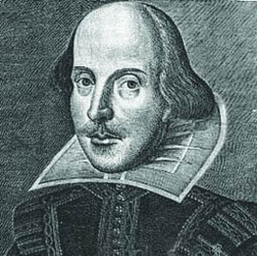
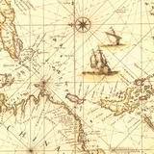
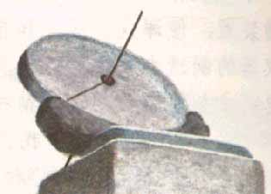
Opinions Come with Context
Source
Author
How to benefit from context?
Q2
Time
Location

Slide 5
Statistical Topic Models: PLSA
[Hofmann 99], [Zhai et al. 04]
Topic model
= unigram language model
= multinomial distribution
Document
Topics
Generate a word in a document
government0.3
response 0.2..
θ₁
π_{d1}
oil 0.1
price 0.05
θ₂
π_{d2}
w
…
π_{dk}
λ_{B}
pray 0.2
bless 0.15
θ_{k}
Is 0.05
the 0.04
a 0.03 ..
Collection background
B

Slide 6
PLSA Estimation
Document
Generate a word in a document
Topics
?
?
θ₁
π_{d1}
?
θ₂
π_{d2}
w
…
Log-likelihood of the collection
?
π_{dk}
λ_{B}
?
θ_{k}
Is 0.05
the 0.04
a 0.03 ..
Collection background
B
Estimated with Maximum Likelihood Estimator (MLE) through an EM algorithm

Slide 7
Exploiting Expert Opinions in PLSA
How to integrate and benefit from both?
Q1
[Lu & Zhai www08]
Document
Add as
Dirichlet priors
Topics
Government
response
r₁
θ₁
Expert Opinions
π_{d1}
1 - λ_{B}
Oil price
r₂
θ₂
π_{d2}
w
Blog
Opinions
…
π_{dk}
λ_{B}
θ_{k}
Is 0.05
the 0.04
a 0.03 ..
Collection background
MLE
MAP
B

Slide 8
Exploiting Opinion Context in PLSA
How to benefit from context?
Q2
Document
[Mei et al. www06]
Topic Coverage condition on context
Topics
θ₁
Year=06
c₁
Spatiotemporal
Context
π_{d1}
1 - λ_{B}
Year=08
c₂
θ₂
w
Blog Opinions
π_{d2}
P(θ_{i}|time, location)
…
π_{dk}
λ_{B}
θ_{k}
P(θ_{i}, location|time)
B
Collection background
Is 0.05
the 0.04
a 0.03 ..
P(time|θ_{i}, location)

Slide 9
Integration on Barack Obama
Bio from Wikipedia | Similar Opinions | Supplementary Opinions
Barack Hussein Obama (born August 0 4, 1961) is the junior United States Senator from Illinois and a member of the Democratic Party. | Senator Barack Hussein Obama is the junior United States Senator from Illinois and a member of the Democratic Party. | Barack Obama, another leading Democratic presidential hopeful, campaigns for more dollars with "Dinner With Barack.”
He lived for most of his childhood in the majority-minority U.S. state of Hawaii and spent four of his pre-teen a years in the multi-ethnic Indonesian capital city of Jakarta. | N/A | Obama was born in Honolulu, Hawaii, to Barack Hussein Obama Sr., a Kenyan, and Kansas born Ann Dunham.
He is among the Democratic Party's leading candidates for nomination in the 2008 U.S. presidential election. | Mr Obama will contest the Democrat presidential nomination | Democratic presidential candidate Barack Obama said Sunday that … Hillary Rodham Clinton, does not offer the break from politics as usual that voters need.

Slide 10
Integration on Hurricane Katrina
Intro from Wikipedia | Similar Opinions | Supplementary Opinions
… making it the deadliest U.S. hurricane since the ... Randall Bell wrote : “ .. Preliminary damage estimates were well in excess of $100 billion , eclipsing many times the damage wrought by Hurricane Andrew in 1992 . " | … in excess of 100 billion, eclipsing many times the damage wrought by Hurricane Andrew in 1992. 5 " The storm is estimated to have been the costliest tropical cyclone in U.S. history | Even if the levees hadn’t burst and New Orleans didn’t flood, Hurricane Katrina would still be the largest natural disaster this country has ever faced, and the rebuilding effort will be certainly be the largest and costliest of its kind.
The levee failures prompted investigations of their design and construction…, resulting in the resignation of … director Michael D. Brown | N/A | Full Story Top E Mails: Brown Discounted Levee Breach Wed, 10 May 2006 09:55 am PDT AP Hours after Hurricane Katrina hit,
Four years later , thousands of displaced residents in Mississippi and Louisiana were still living in trailers. Reconstr. of … has been addressed … | N/A | on the third anniversary of Hurricane Katrina … Senator Obama released the following statement on the importance of following through with our commitment to the region…

Slide 11
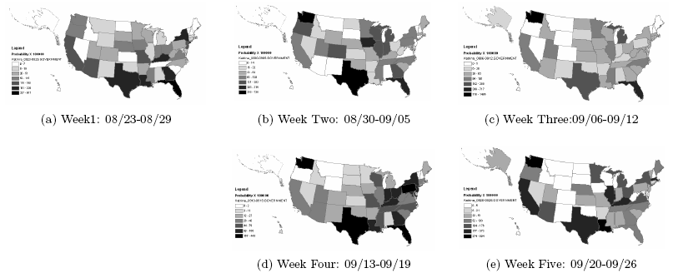
Spatiotemporal Analysis on Hurricane Katrina
Snapshot of Topic Coverage
P(θ_{i}=Government Response, location|time)
Hurricane
Katrina

Slide 12
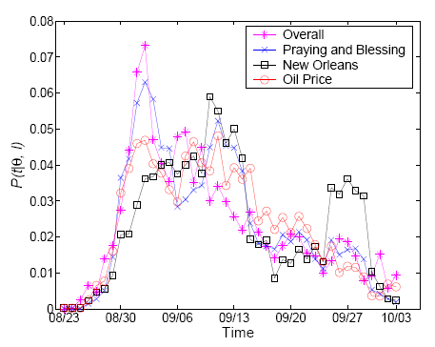
Spatiotemporal Analysis on Hurricane Katrina
Topic life cycle
P(time|θ_{i}, location=Texas)
Hurricane
Katrina

Slide 13
Summary
Problem: opinion integration and analysis
Approaches:
  Unsupervised statistical topic models
  Domain independent, general and robust
Many potential applications:
  Intelligence analysis
  Public opinion tracking
  …
Future Work:
  System/toolkit building
  More interactive support
  More NLP: co-reference

Slide 14
Thank You!

