Slide 1

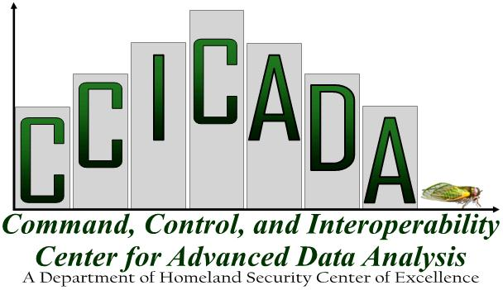
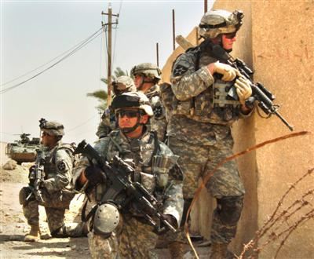
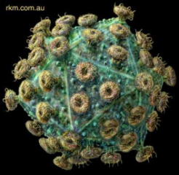

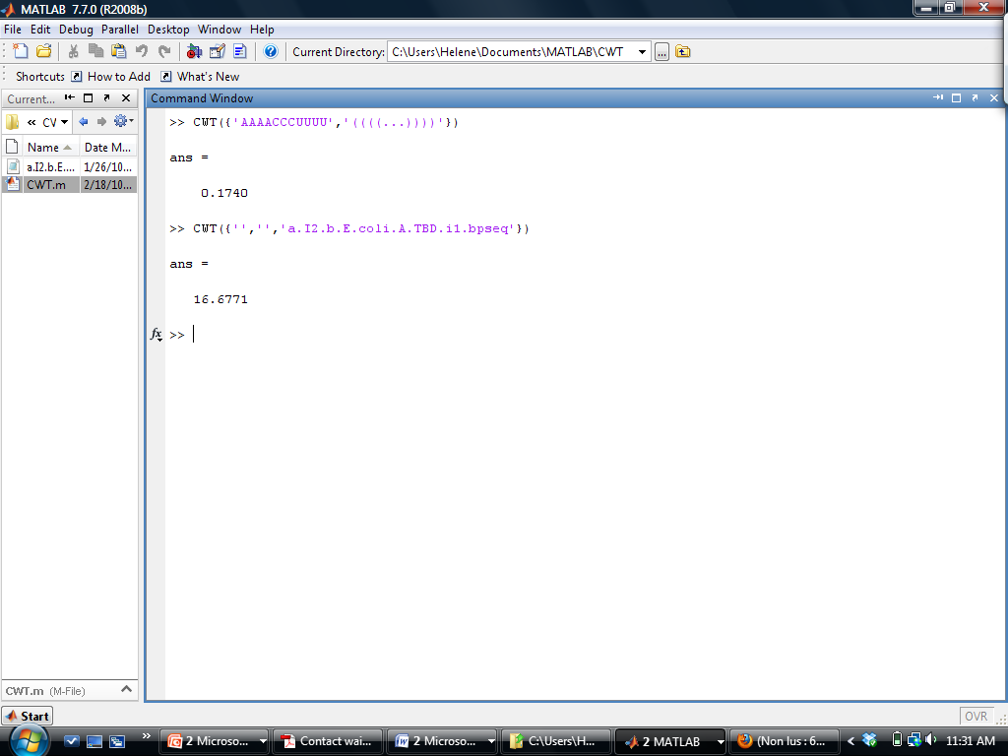
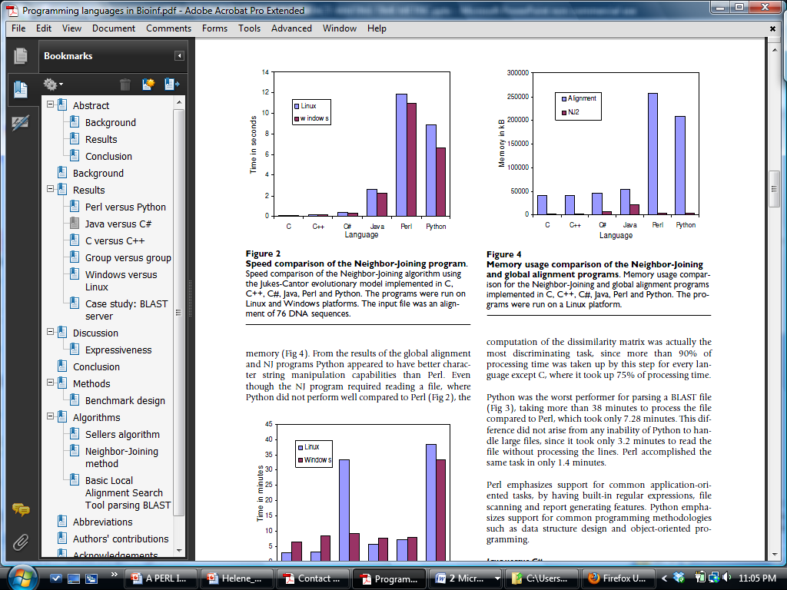
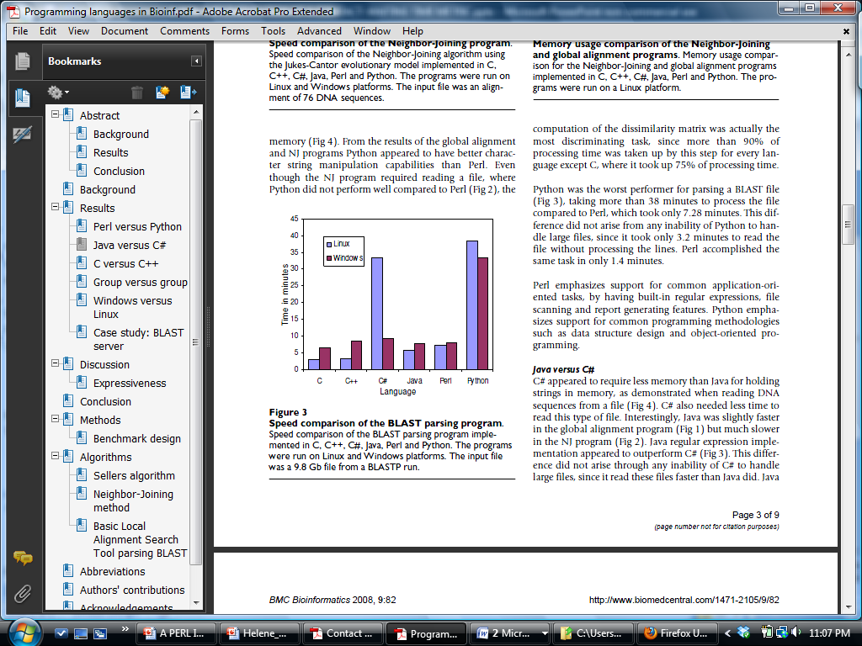
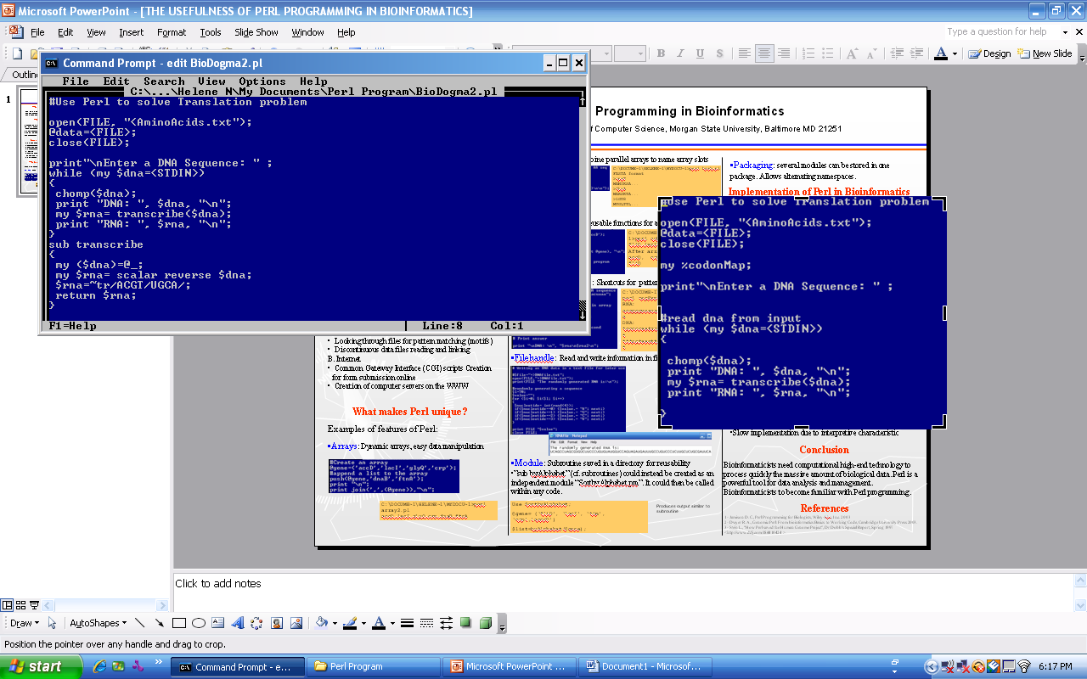
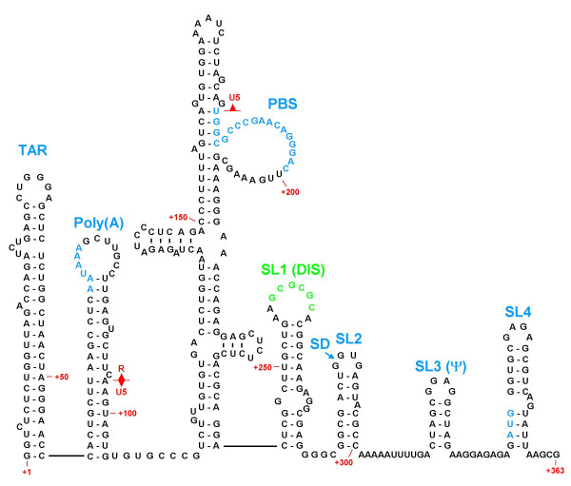
A PERL IMPLEMENTATION OF A CONTACT-WAITING TIME METRIC FOR HIV-RNA FOLDING PREDICTION: ARE THERE NATIONAL SECURITY IMPLICATIONS?
Helene Nguewou¹, Asamoah Nkwanta². ¹Department of Computer Science, ²Department of Mathematics, Morgan State University, Baltimore MD 21251
Abstract
This work focuses on creating a user-friendly prediction tool for RNA folding kinetics in Perl language. The contact-waiting time (CWT) metric is applied to certain HIV sequences in order to calculate their folding rates. The algorithm used to compute the CWT metric will be converted from MATLAB to Perl language and tested on sequences obtained from HIV databases. The purpose of creating the Perl implementation is to make the CWT more widely available and easy to use as a bioinformatics tool. In addition, since HIV is an RNA virus are there national security implications as a result of HIV sequence prediction analysis? At least 39 million people now infected with the virus are expected to die in the next 5-10 years. This could cause a depletion of domestic and elite workers and professionals and represents a possible threat to homeland security. The disparity of access to retroviral drugs increases the widening life-expectancy gap between poor countries and Western countries. As a result of this, there is increasing concern that nations highly infected with HIV might engage in HIV related bioterrorist acts against the United States. The lack of an effective and affordable vaccine against the virus makes this threat even more conceivable. Therefore, HIV research efforts to help prevent a possible HIV attack are novel and of high importance.
Contact-Waiting Time (CWT) metric
Accounts for the energetic contributions of RNA base contacts.
Accounts for entropic costs associated with the nucleation of RNA helices.
Other parameters: Length of sequence, Type of contacts , environment temperature, ionic concentration.
CWT highly correlates (correlation coefficient: -0.95, p << 0.01) with the logarithm of the RNA folding rates.
Possible Implications for National Security
Poor sexual behavior of Military forces exposes them to higher infection rate than civilian population.
HIV may be used as a terrorist bomb to infect society home and abroad.
  Understanding RNA folding rate might give us insight into early detection or vaccine design.
  Understanding RNA folding kinetic may lead to the design of an aptamer sequence that inhibits folding of HIV.
Where ΔG_{ij}: energetic contributions due to i^{th} and j^{th} contacting bases
For helix nucleating contact
For non-helix nucleating contact
Comparison of Programming Languages Used in Bioinformatics
C and C++: compiled languages, high computation speed and low memory, requires extensive coding, suit system-intensive tasks
Perl and Python: interpreted languages, flexible, efficient with large databases, automatic memory assignment, low speed of execution
C# and Java: semi-compiled languages, almost as fast as C and C++, but require more memory space than all other languages
Overall, Perl offers a better string manipulation, and higher efficiency in dealing with large files
MATLAB Implementation
CWT metric applied to sequences which folding rates are known experimentally
Input: RNA sequence and secondary structure in the dot-brackets format, or a BPSEQ file containing both the sequence and secondary structure.
?
http://img393.imageshack.us/img393/2136/zcustomtm5.jpg
http://justmytruth.files.wordpress.com/2009/05/american-flag-and-eagle.jpg
http://img393.imageshack.us/img393/2136/zcustomtm5.jpg
HIV Virus
National Security
CWT implemented on two sequences in MATLAB
Conclusions
RNA folding rate prediction using CWT metric highly correlates with logarithmic values of the folding time.
A user-friendly software for RNA folding prediction using CWT metric will be implemented in Perl language.
HIV may be used as a bioterrorist weapon home and abroad.
Understanding HIV-RNA folding kinetic might help in design of early prevention or treatment plans.
Some Features of Perl Implementation
Cross platform portability
Good string processing
Flexible syntax and file handling
Hash tables, regular expressions
Subroutines, modules, packages
Enthusiastic user community
Free software
Database
Perl code
Language interpreter
If error
Future Work
Implement the Perl Program
Implement and test on other biological databases
Investigate whether understanding of HIV folding kinetics helps identify early threats of HIV related bioterrorist acts.
Machine executable binary
Error statement
Exit command prompt
Memory usage comparison of the Neighbor-Joining
and global alignment programs.
(Source: Fourment and Gillings)
Speed comparison of the BLAST parsing program
If no error
Run the script
Flow chart for execution of Perl programs
Motivation
Implement in Perl language a user-friendly prediction tool for RNA folding rates for bioinformatic applications.
C:\DOCUME~1\HELENE~1\MYDOCU~1\PERLPR~1>perl BioDogma2.pl
Enter a DNA Sequence: ACCATGGATAGACCATTAAGGAC
DNA: ACCATGGATAGACCATTAAGGAC
RNA: GUCCUUAAUGGUCUAUCCAUGGU
Acknowledgements
The MSU CCICADA Grant
Example of Perl program in Bioinformatics
Procedure
Convert a MATLAB program to calculate CWT metric into a Perl language
Test the Perl implementation against experimental database
Apply the Perl program to predict folding rates of a chosen HIV database
Expected Results
Implementation of a user-friendly yet powerful tool to predict folding rate.
Successful application to calculate folding rate of certain HIV sequences.
Perl implementation will be more efficient than MATLAB implementation.
HIV-1 Secondary Structure
References
Fourment M., Gillings M., A comparison of common programming languages used in bioinformatics, BMC Bioinformatics 2008, 9:82
Garrett, L., HIV and National Security: Where Are the links?, Council on Foreign Relations, http://www.cfr.org/publication/8256/hiv_and_national_security.html
Ritzenthaler, R., On The Front: HIV?AIDS And the Uniformed Services, http://img.thebody.com/press/2005/uniformed_services.pdf
Nkwanta A., Ndifon W., A contact-waiting-time metric and RNA folding rates, FEBS Letters, Vol. 583:14, 2392-2394
Ndifon W, Nkwanta A., An RNA foldability metric; implications for the design of rapidly foldable RNA sequences, Biophysical Chemistry, 2006 Vol.120:3, 237-239
Waterman M., Introduction to Computational Biology 1st Ed., Chapman & Hall, 1995.

