Slide 1
Enhancing student engagement in cyber security education
Dr. Costis Toregas
GW Cyber Security Policy and Research Institute
and
National CyberWatch Center

Slide 2
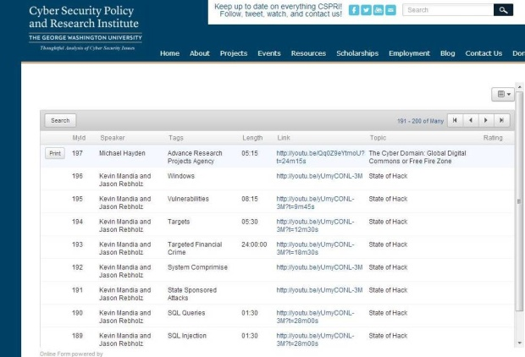
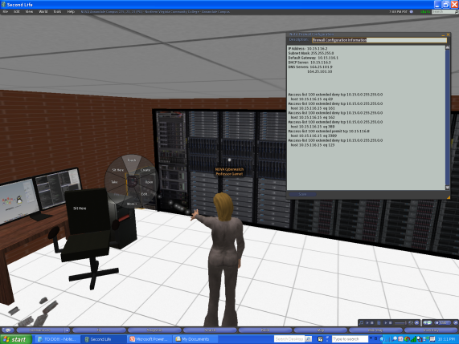
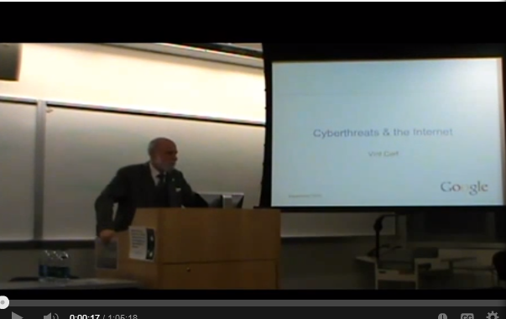
Broad palette of tools
Hybrid courses with Washington experts
F2F over 4 semesters
Summer of 2013 in hybrid mode
Sea to Shining Sea experiment for sharing
Second Life for Policy & Compliance
Cloud-based exercises and competitions
Dr. Costis Toregas toregas1@gwu.edu CyberSecurity Education Brainstorming Rutgers University 10/7/13

Slide 3

National Cyber League
Collaboration between 4 ATEs (NCC, CSSIA, CWW, MPICT) and GWU
Fall 2013 Season with 900+ participants from 30 states starting this week
Labs in CompTIA Security+™ and EC-Council Certified Ethical Hacker (CEH)™
Balance between educational and competition objectives
Dr. Costis Toregas toregas1@gwu.edu CyberSecurity Education Brainstorming Rutgers University 10/7/13

